Slide 1


Green Pace
Security Policy Presentation
Developer: Brennon Fultz
Secure Coding Policies in C++

Slide 2

OVERVIEW: DEFENSE IN DEPTH
This security policy covers how to prevent vulnerabilities in C++ by employing best practices.
Security policies are needed to define the expectations of secure coding practices.
Secure coding supports defense-in-depth by acting as a layer to prevent breaches.

Slide 3
THREATS MATRIX
Threats fall into four main categories: likely, unlikely, low priority, and priority.
Likely STD-008-CPP STD-009-CPP | Priority STD-002-CPP STD-003-CPP STD-004-CPP STD-005-CPP
Low priority STD-001-CPP STD-007-CPP | Unlikely STD-006-CPP STD-010-CPP

Slide 4
10 PRINCIPLES
Principle | Applicable Standard(s)
Validate Input Data | 3, 4
Heed Compiler Warnings
Architect and Design for Security Policies | 5, 6, 7, 8, 9
Keep It Simple | 1, 10
Default Deny
Adhere to the Principle of Least Privilege
Sanitize Data Sent to Other Systems | 2, 7
Practice Defense in Depth
Use Effective Quality Assurance Techniques | 1, 3, 5, 6, 9
Adopt a Secure Coding Standard

Slide 5
CODING STANDARDS
STD-003-CPP: Guarantee that storage for strings can hold the null terminator
STD-004-CPP: Exclude user input from format strings
STD-005-CPP: Do not access freed memory
STD-002-CPP: Do not pass a non-null terminated character sequence to a library function that expects a string
STD-008-CPP: Ensure unsigned integer operations do not wrap
STD-009-CPP: Do not attempt to modify a string literal
STD-001-CPP: Do not use floating point variables as loop counters
STD-007-CPP: Handle all exceptions
STD-010-CPP: Never qualify a reference type with const or volatile
STD-006-CPP: Use assertions only to incorporate diagnostic tests
In order of priority, which is determined by a combination of the severity, likelihood, and remediation cost.

Slide 6
ENCRYPTION POLICIES
Data at rest is any data that is in storage, such as in a database. Data at rest must always be encrypted to prevent breaches from leaking sensitive information.
Data in flight is data that is being transmitted over a network. This data must also always be encrypted before transmission and decrypted on receipt, even on internal networks.
Data in use is data that is being actively used and may be difficult to encrypt while remaining useful. Highly sensitive data should be accessed while encrypted through runtime or homomorphic encryption.

Slide 7
TRIPLE-A POLICIES
Authentication, or proving one’s identity before accessing a system, is a basic security practice. Multi-factor authentication should be used to access company accounts.
Authorization is the actions an authenticated user is allowed to take. RBAC should be implemented based on what essential functions the user needs to do their job.
Accounting is the process of logging access and actions. Access logs should be maintained to identify who is taking which actions and when.

Slide 8
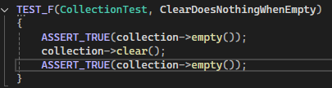
Unit Test: Clear Does Nothing When Empty
This unit test checks whether the clear() method does nothing when the collection is empty, as expected.

Slide 9
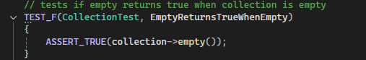
Unit Test: Empty Returns True When Empty
This unit test checks whether the empty() method returns true when the collection is empty, as expected.

Slide 10
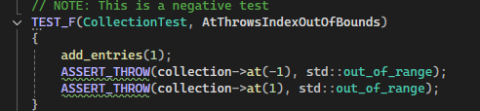
Unit Test: At Throws IndexOutOfBounds
This unit test checks whether the at() throws an indexOutOfBounds exception when passed an invalid argument.

Slide 11
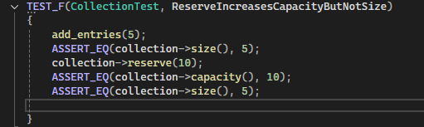
Unit Test: Reserve Increases Capacity But Not Size
This unit test checks whether the reserve method increases the collection capacity but not the size.

Slide 12

AUTOMATION SUMMARY

Slide 13
TOOLS
Automation of the enforcement of these coding standards will become part of the development lifecycle as the DevOps process is converted to DevSecOps.
In the design and build stage, CI/CD automation tools such as Jenkins can implement dependency checking like OWASP to verify the security of third-party libraries
The main enforcement of this policy will be automated in the build stage before testing, with Astree and any other necessary security checkers added to the pipeline to ensure compliance
Other static analysis tools such as RuleChecker will be used in the Verify and Test stage to ensure compliance and identify other vulnerabilities
LDAP and AP will be used to manage roles and role-based access control automatically as well as logs in the Monitor and Detect stage

Slide 14
RISKS AND BENEFITS
By implementing this policy immediately, the company can benefit by having a set standard which employees can refer to and understand expectations.
This policy will enhance the security of code produced by the company and lead to fewer threats and vulnerabilities.
The encryption guidelines will fix a critical security flaw in the current company practice and ensure data is protected.
Multi-factor authentication and RBAC will prevent access to secure systems from outside attackers.
However, if the policy is implemented with no further review or revision, there is a risk of vulnerabilities being overlooked.

Slide 15
RECOMMENDATIONS
Further analysis and improvement on this policy could offer even better security, and expanding this policy to encompass other areas of security would improve the defense-in-depth approach.
While secure coding principles and standards, encryption, and triple-A offer a good basis for security, these could be improved on with the addition of third-party penetration testing.
Penetration testing is the practice of attempting to breach a secure system in order to discover and fix security flaws (IBM, 2023).
Penetration testing on systems and staff should be conducted quarterly to assess vulnerabilities. Staff testing should consist of phishing emails.

Slide 16
CONCLUSIONS
This policy should be enacted immediately but expanded to include a new company practice of quarterly penetration testing to assess security vulnerabilities. Phishing emails should be used to identify any staff that may need additional training on security best practices, while software systems should be tested with attacks from a third party testing vendor. Any vulnerabilities found should be assessed and fixed in order of priority.

Slide 17
REFERENCES
IBM, 2023. What is penetration testing? International Business Machines. Web. https://www.ibm.com/think/topics/penetration-testing

